Slide 1


Total Energies Steering Committee 1
Master X-HEC – 23.01.2023 © Capgemini 2023. All rights reserved | 1

Slide 2






Team & Presenters
Thomas Philipp SCHNEIDER
DSB-Student @X-HEC
thomas-philipp.Schneider@
polytechnique.edu
Shihan YE​
DSB-Student @X-HEC
shihan.ye
@polytechnique.edu
Harshit SHANGARI
DSB-Student @X-HEC
harshit.shangari@polytechnique.edu
Guillaume D'HÉROUVILLE​
DSB-Student @X-HEC
guillaume.dherouville.2022@
polytechnique.edu
Kaan ÇAYLAN
DSB-Student @X-HEC
kaan.caylan@
polytechnique.edu
Rehan Ibrahim AMJAD
DSB-Student @X-HEC
amjad-rehan.ibrahim@
polytechnique.edu

Slide 3

Agenda
4. Technical Stages
Web Scraping
Data Preprocessing
Embedding
5. KPI Definition
6. Future steps
7. Summary
Introduction
Industry benchmark analysis
Customer journey and pain points

Slide 4
Problems & Goals
Problems | Goals
Increased competition due to rising energy prices. | Analyze the customer feedback using NLP, to identify the key pain points that need to be addressed to improve the customer journey
Lack of differentiation, risk of increased churn rates due to intensifying competition | Provide recommendations to TotalEnergies to help them differentiate themselves and adapt to the increased competition

Slide 5
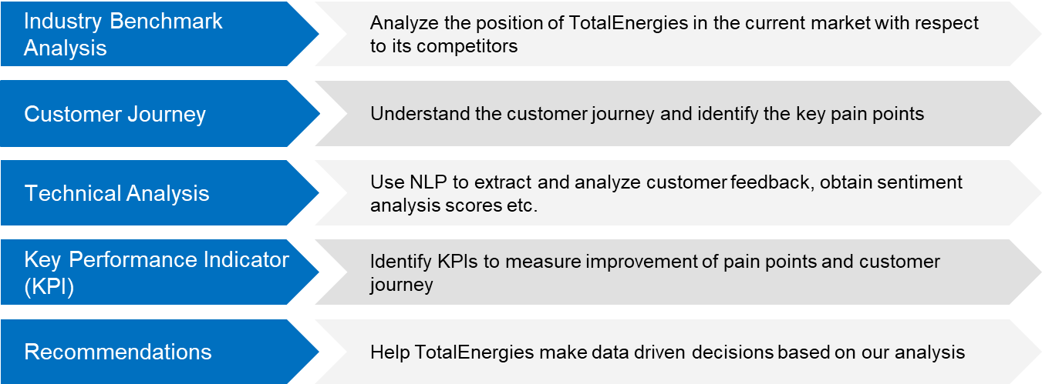
Approaching the Problem

Slide 6
Agenda
4. Technical Stages
Web Scraping
Data Preprocessing
Embedding
KPI Definition
Future steps
Summary
Introduction
Industry benchmark analysis
Customer journey and pain points

Slide 7


Assumptions and Methodologies
Assumptions
Methodologies
Energy Market: Unstable with intensifying competition
Standard household consumption
Energy Prices: Soaring energy prices
Regulations: Stable with no major changes
Industry: Identify relevant industry for TotalEnergies.
Competitors: Identify key competitors and their postion
Benchmarking: Compare Total Energies to competitors using metrics
Conduct SWOT analysis and draw insights

Slide 8

Benchmarks
Key benchmarks in the energy industry
Price: Affordability and value offered to customers
Contract duration: Flexibility and commitment towards customers
Customer satisfaction: Quality of service and customer experience
Use of renewable energy: Focus on sustainability and commitment to a greener future
Comprehensive view of TotalEnergies performance helps in understanding TotalEnergies position in the industry.

Slide 9


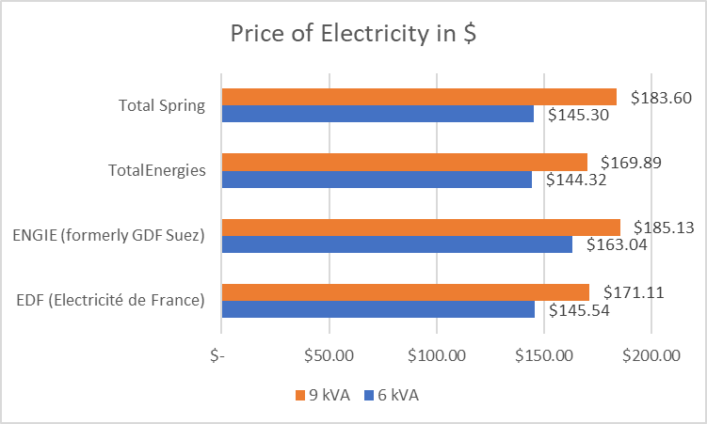
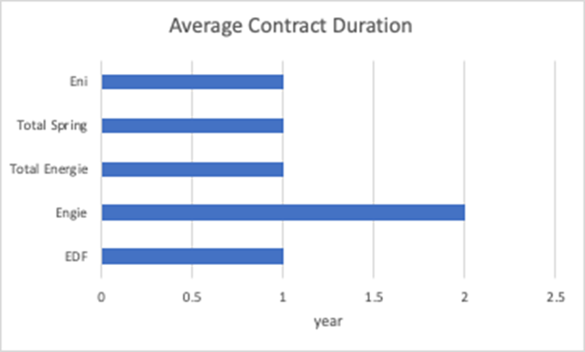
Price and Contract Duration
TotalEnergies leads the market in pricing, with best price per 9kVA & 6kVA
TotalEnergies' one-year contract standard aligns with industry norms.

Slide 10


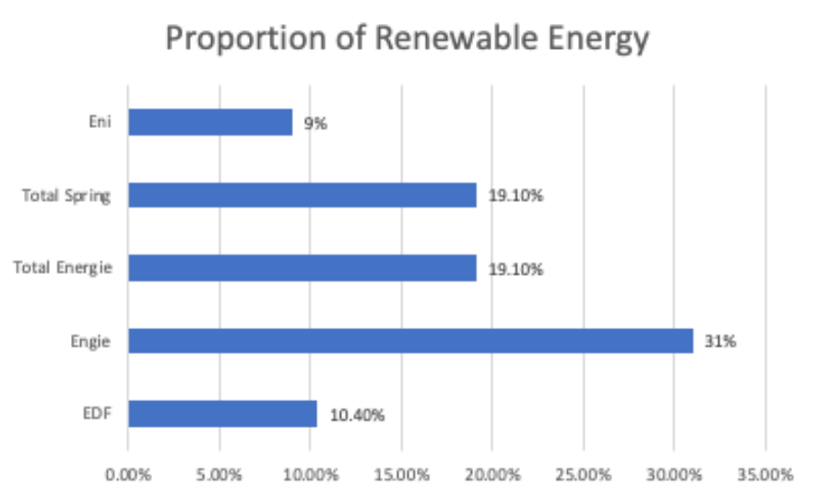
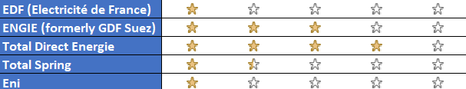
Customer Satisfaction and Renewable Energy
In terms of customer satisfaction TotalEnergies leads the market. It is the only company with a rating above 3.5 out of 5.
TotalEnergies has a slightly above average production of renewable energy, with competitors such as Engie leading the market by a significant margin.

Slide 11
Agenda
4. Technical Stages
Web Scraping
Data Preprocessing
Embedding
KPI Definition
Future steps
Summary
Introduction
Industry benchmark analysis
Customer journey and pain points

Slide 12
TotalEnergies – Steps and Pain Points
1
Stages
Awareness: Benefit of/ Need for new supplier
Consideration: Market Research
Evaluation: Choice of Shortlisted Supplier
Purchase: Choose Total & Sign Contract
Loyalty: Long term Satisfaction
2
Steps
Customer Relocates: no existing energy supplier & need for new supplier
Phones TE
for details of options
Research of offers
on Total website
Visits comparison site and review site (Trustpilot)
Gets advice from family and friends
Shortlists options based on research
Picks fixed Green or EcoHours;
electricity and/or gas
Agrees to terms and makes purchase
Leaves good review
Contacts customer service about price increase
Chooses add-ons
Chooses contract start date
Downloads TE app to track usage
Refers friends & family
Customer is made aware of better offers
Begins online
form for details of options
Clicks Facebook ad
Watches TV ad
Reads
print ad
SEO/ SEA
(optional)
(optional)
3
Touchpoints
Googles energy questions
e.g. how to save energy cost
Trustpilot/ Hellowatt,
competitor homepage
Homepage or
calls customer service
Homepage or
calls customer service
Writes email or
calls customer service
Campaign website/
TE homepage
TE homepage
Trustpilot/ Hellowatt,
Facebook ad
Downloads TE App
TV ad
Print ad
4
Pain points
“Warning” Ribbon on Total Website
Lower price of competitors,
worse ESG,
bad reviews
Info on price & options only after start purchase process, Call is partially automated
Quality of customer service: Waiting time, partially automated phone system, friendliness, no chatbot available
Price increases, no loyalty program, limitations of app , electricity outages, poor quality of customer service : waiting times, unconvincing explanation of price increase

Slide 13
Customer Journey TotalEnergies – Channels used
4
8
10
0
1
2
3
5
6
7
9
I see an add of TE with an interesting offer
I research the offers of TE
I get the details of the two options that TE offers
I choose the option that I like best
I choose the Add- ons that suit me
I choose the contract start date
I agree to the terms and make the purchase
I download the TE app (to track my electricity usage)
I refer friends
and family
I leave a review of TE
I contact
customer service
about the price
increase
Online
TE Homepage
Social Media
Mobile App
Phone
Offline
Direct touchpoint :
Available
Unavailable
The homepage can be accessed both through PCs as well as mobile devices. Social media is predominately accessed through mobile devices. The Mobile App is exclusive to mobile devices.

Slide 14
Agenda
4. Technical Stages
Web Scraping
Data Preprocessing
Embedding
KPI Definition
Future steps
Summary
Introduction
Industry benchmark analysis
Customer journey and pain points

Slide 15
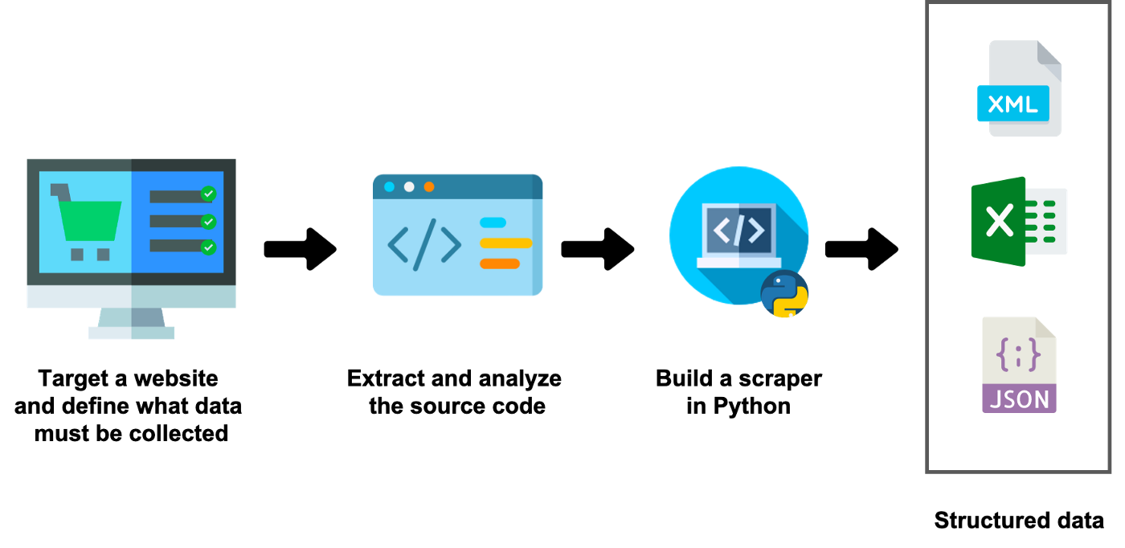

Web scraping
Selenium

Slide 16
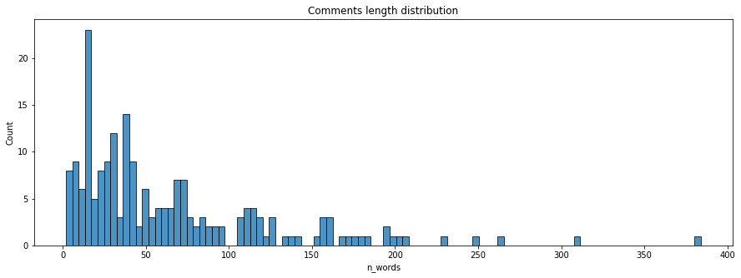
Text Preprocessing
Tokenization
Unigram
Bigram
Special Characters
Lowercase transformation
Punctuation
Letters with accents
Emojis and Whitespace
Additional Corrections
Stopwords
Stemming
Lemmatization

Slide 17
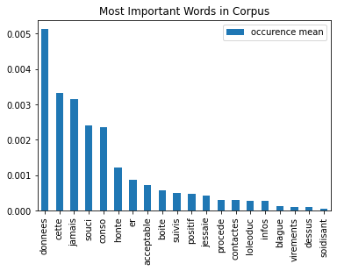
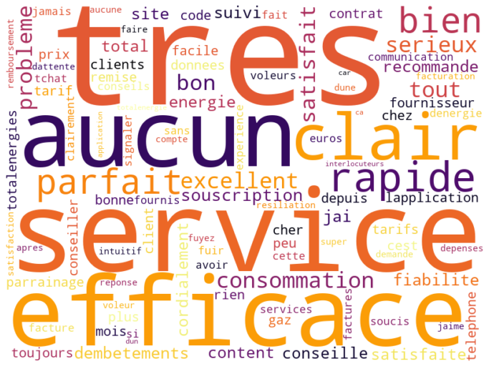
TF-IDF Results

Slide 18
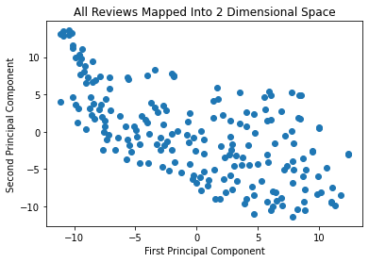
Word2Vec
Converting words into numerical vectors to prepare for Sentiment Analysis.

Slide 19
Agenda
4. Technical Stages
Web Scraping
Data Preprocessing
Embedding
KPI Definition
Future steps
Summary
Introduction
Industry benchmark analysis
Customer journey and pain points

Slide 20




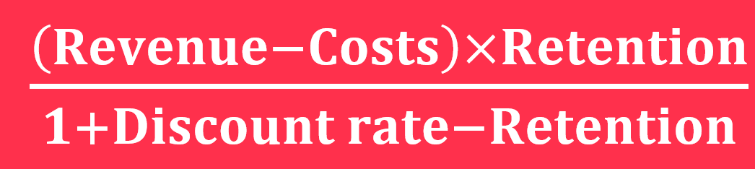



Key Performance Indicators (KPI)
Awareness
Loyalty
Purchase
Evaluation
Consideration
Targets​
Marketing revenue attribution
Customer acquisition cost per marketing channel
Traffic-to-lead-rate
Landing page conversion rate
Time spent on website
Lead-to-customer-rate
--> for homepage
--> for customer service
Customer retention rate
Churn rate
Number of Customer Complaints by period
Sentiment score of reviews
Customer lifetime value (CLV)
Measurements & Implementations
Single or multi touch attribution models using Hubspot
Calculating total Costs incurred, CAC can be calculated through tools like Salesforce/in-built tools in GoogleAds
Define a lead (person who fills a form), Track the number of visitors and leads
Implement marketing automation software (such as Pardot) to track time spent
Revenue: Forecast future revenue based on market
Costs: Forecast costs to produce electricity, cost to serve customer and cost to retain customer
Retention: 1 minus expected future churn rate
Discount rate: Weighted avg. cost of capital
Homepage:
Customer service:
Customer retention rate :
Calculated the number of customer complaints in a specific period using automated tools
Calculate sentiment scores through reviews using NLP
Notes:
Single or multi touch attribution models using Hubspot
Calculating total Costs incurred and total number of customers acquired, CAC can be calculated through tools like Salesforce/in-built tools in GoogleAds
implement marketing automation software (such as Marketo or Pardot) to track time spent

Slide 21
Agenda
4. Technical Stages
Web Scraping
Data Preprocessing
Embedding
KPI Definition
Future steps
Summary
Introduction
Industry benchmark analysis
Customer journey and pain points

Slide 22



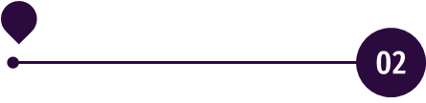
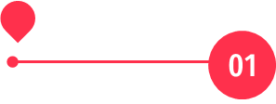
Future steps
KPI evaluation : assess how effective our strategy is, and continue accordingly
Recommendations : give TotalEnergy insights to improve customer relations
Technical development : topic extraction, followed by sentiment analysis, to provide insights into pain points and the current customer journey
Current stage : mid-project, analysis on-going
Technical aspect : word embedding done

Slide 23
Agenda
4. Technical Stages
Web Scraping
Data Preprocessing
Embedding
KPI Definition
Future steps
Summary
Introduction
Industry benchmark analysis
Customer journey and pain points

Slide 24


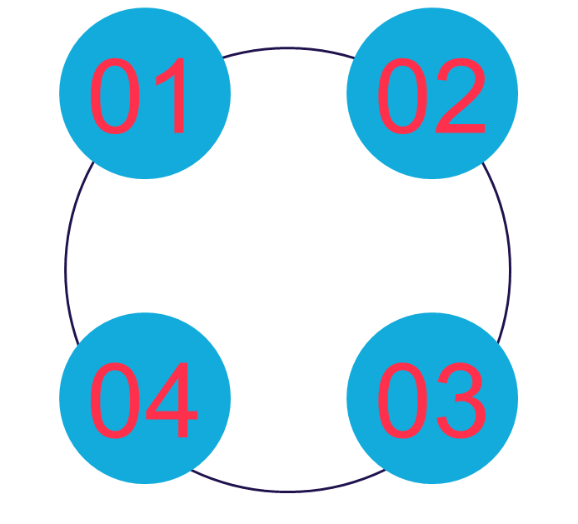


Summary
Industry benchmark analysis :
Price
Customer satisfaction
Contract duration
Use of renewable energy
Customer journey :
Awareness
Consideration
Evaluation
Purchase
Loyalty
KPI Definition :
Targets
Measures & implementation
NLP Implementing :
Web Scraping​
Data Preprocessing​
Embedding​

Slide 25
References
Renewable Energy
https://www.edf.fr/en/the-edf-group/producing-a-climate-friendly-energy#:~:text=In%20France%2C%20the%20electricity%20produced,nuclear%20power%20and%20renewable%20energies.
https://www.engie.com/sites/default/files/assets/documents/2021-09/ENGIE-ChiffresCle2021-EN-WEB_0.pdf
Contract Duration
https://www.edfenergy.com/sme-business/customer/renewals
https://particuliers.engie.fr/aide-contact/questions-reponses/mon-espace-client/contrat/contrat-se-termine-quand.html
https://en.selectra.info/energy-france/suppliers/total-direct-energie
Customer Service
https://fr.trustpilot.com/review/totalenergies.fr
https://fr.trustpilot.com/review/engie.fr
https://fr.trustpilot.com/review/edf.fr
https://fr.trustpilot.com/review/total-spring.fr
https://fr.trustpilot.com/review/eni.fr
Price Comparison
•https://www.fournisseurs-electricite.com/en/edf
https://www.fournisseurs-electricite.com/en/engie

Slide 26
Thank you! WE ARE OPEN TO QUESTIONS
Master X-HEC – 23.01.2023 © Capgemini 2023. All rights reserved | 1

